Slide 1
Using Naviance
Your Future Planning Tool
Ms. Farthing (A-D)
Ms. Jacobson (E-K)
Ms. Humphreys (L-R)
Ms. Joyce (S-Z)

Slide 2
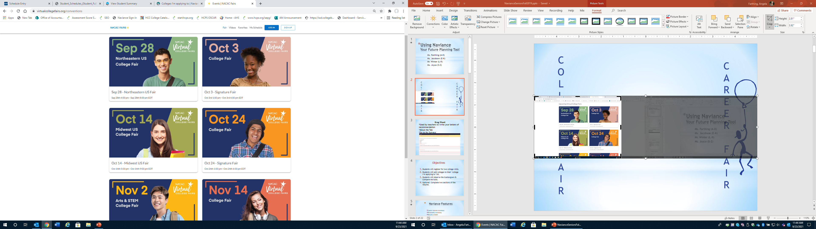
https://www.nacacfairs.org/
C
O
L
L
E
G
E
F
A
I
R
C
A
R
E
E
R
F
A
I
R

Slide 3

Naviance Features:
Career Interest Inventory
Resume creator
Brag Sheet
College and Career planning
Scholarships and Financial Aid opportunities
Request transcripts
Request letters of recommendation
College Visits

Slide 4
Objectives
Students will register for two college visits.
Students will add colleges to their ‘college I’m applying to’ list.
Optional: Complete two sections of the resume.

Slide 5

Let’s Get Started!
Naviance®
    Open itslearning
    Click the Clever tab (top of screen)
    Click the Naviance tile

Slide 6
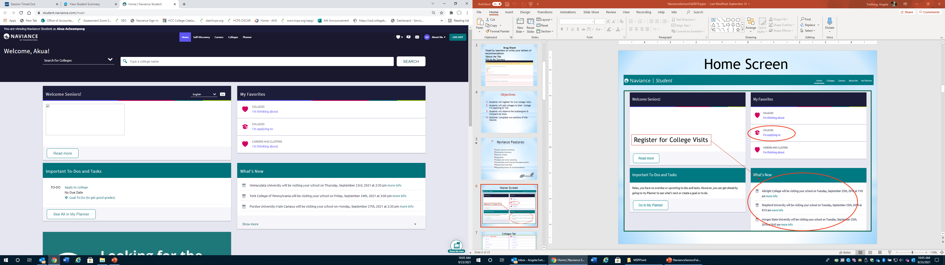
Home Screen
Register for College Visits

Slide 7
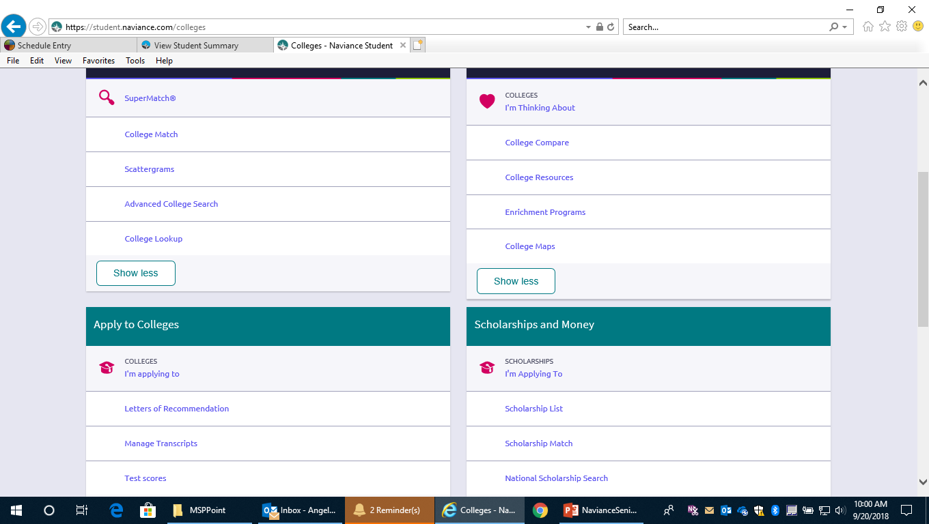
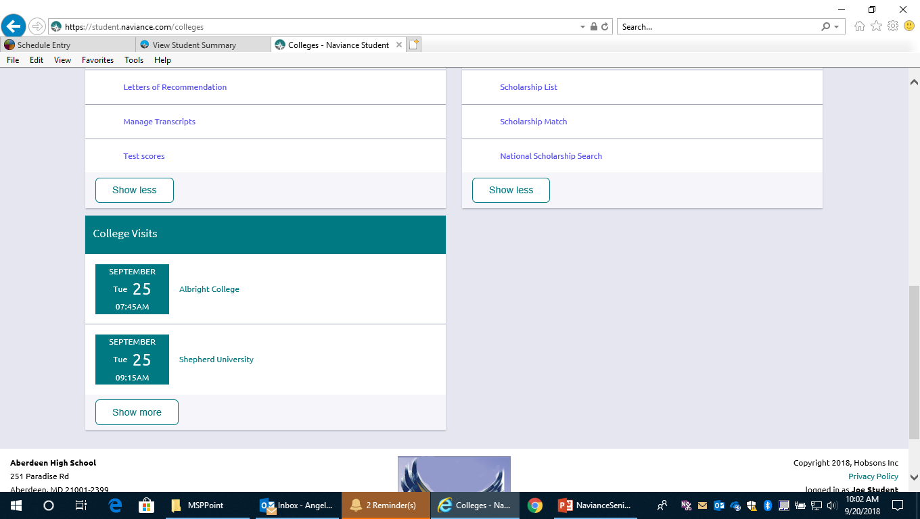
Colleges Home Page

Slide 8
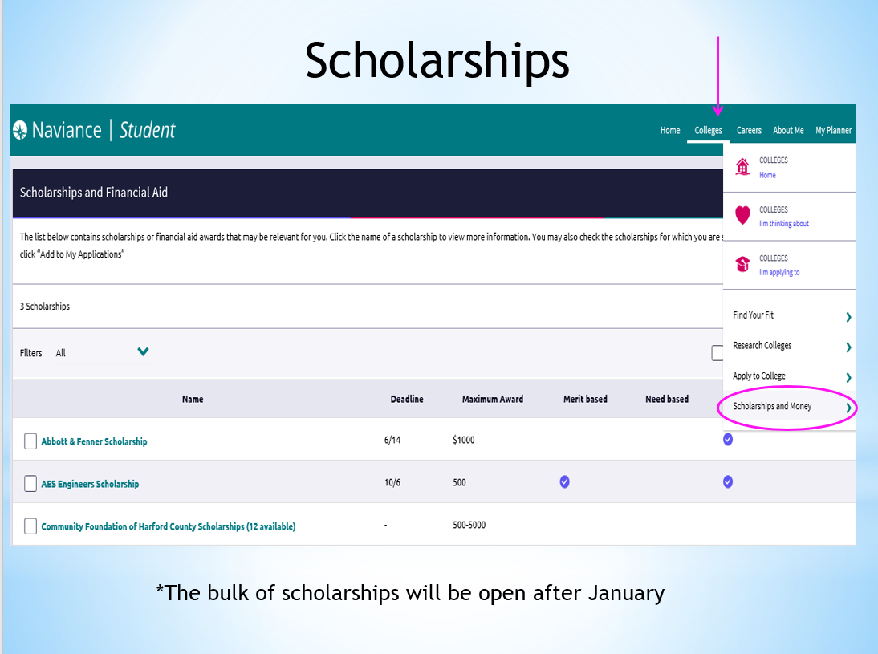

Slide 9
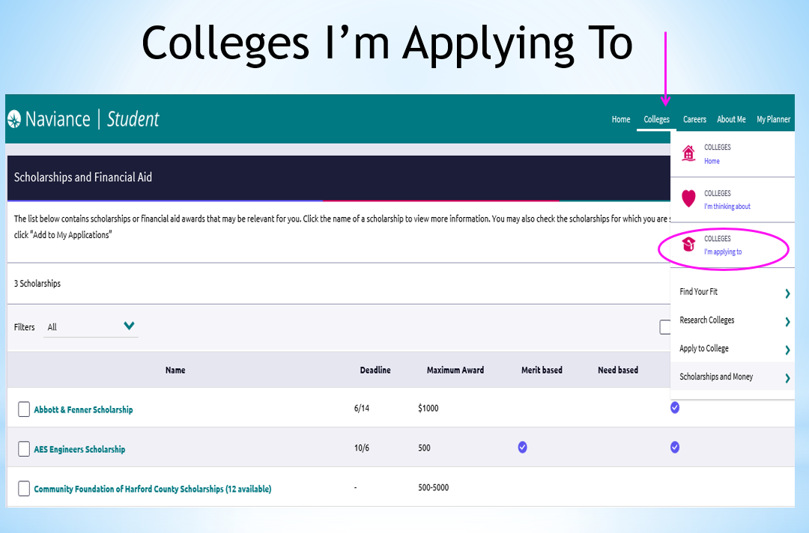

Slide 10
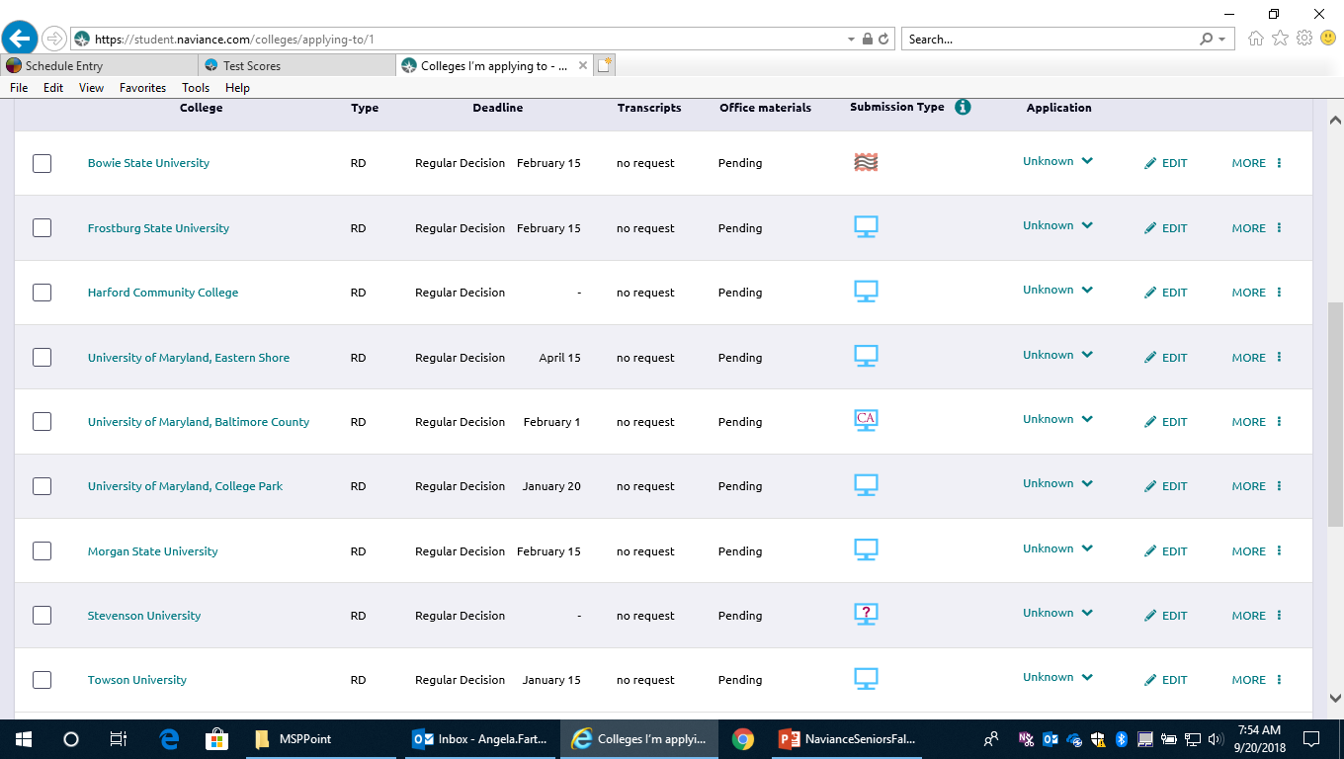
College I’m Applying To

Slide 11
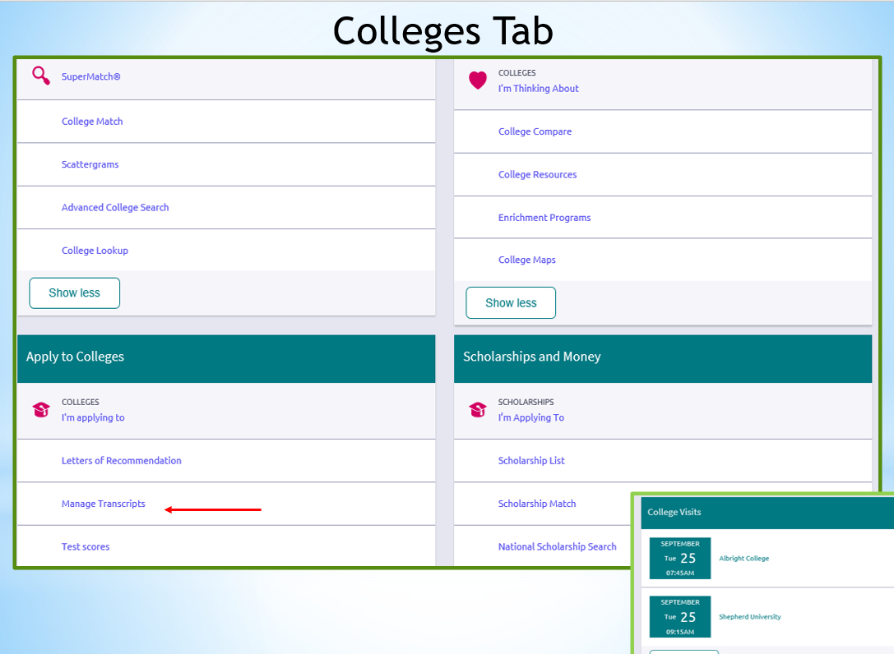

Slide 12
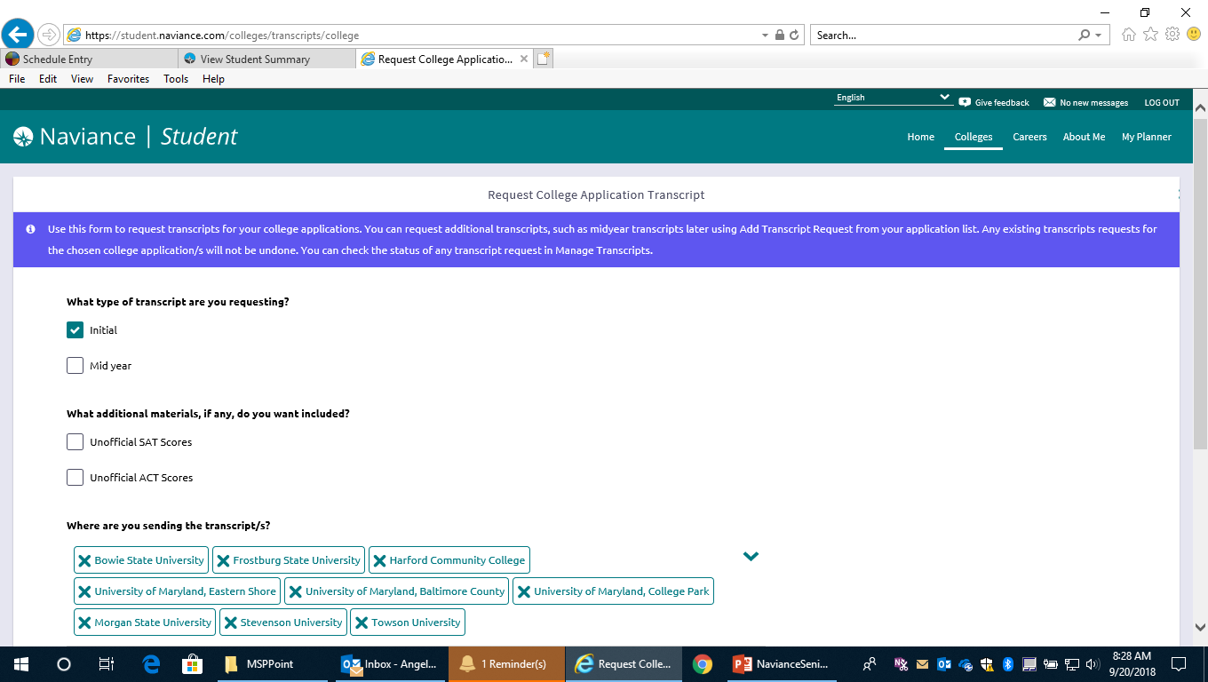
Request Transcripts
*You must contact the testing agency and request your scores be sent to colleges!

Slide 13
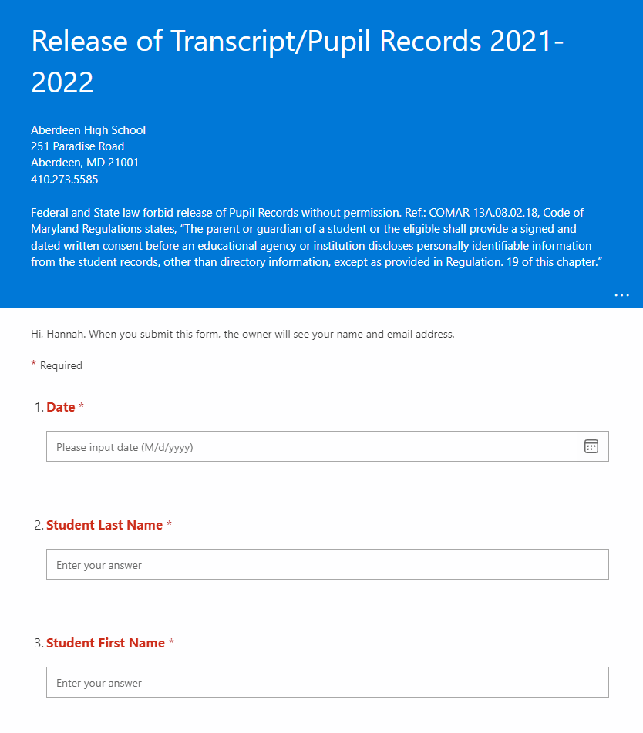
Requesting Transcripts
You must complete the Transcript Release Form before submitting a transcript request
*Gives us permission to send your records to colleges.
*Link to Form will be sent to your student email.

Slide 14


Slide 15
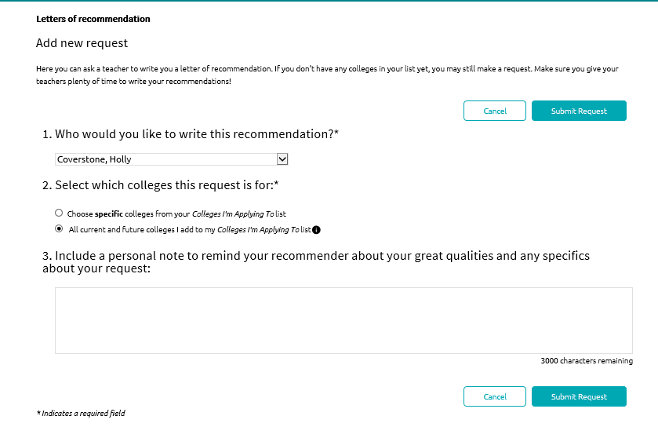
Letters of Recommendation
*Notify your counselor by email when you are requesting a transcript.

Slide 16
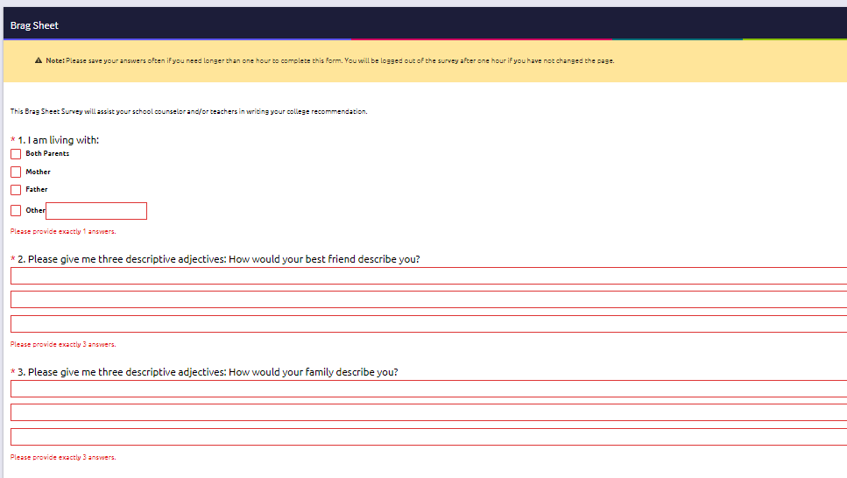
Brag Sheet
Used by teachers to write your letters of recommendation
*About Me
*Surveys From Your School

Slide 17
Submitting your College Application
College Application Platforms
Directly to the instiution
Common Application
Common Black Application
Coalition Application
Some colleges may not use any of the listed platforms and may want you to apply directly on their website
**When requesting transcripts on Naviance, you will select "Directly to the institution" as your submission type if applying directly on the college's website or if using any platform besides Common App

Slide 18
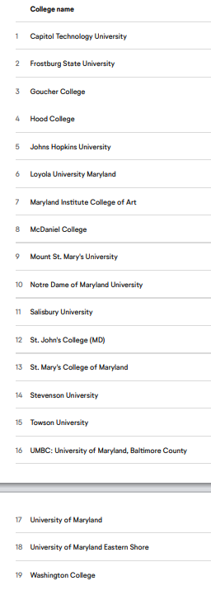
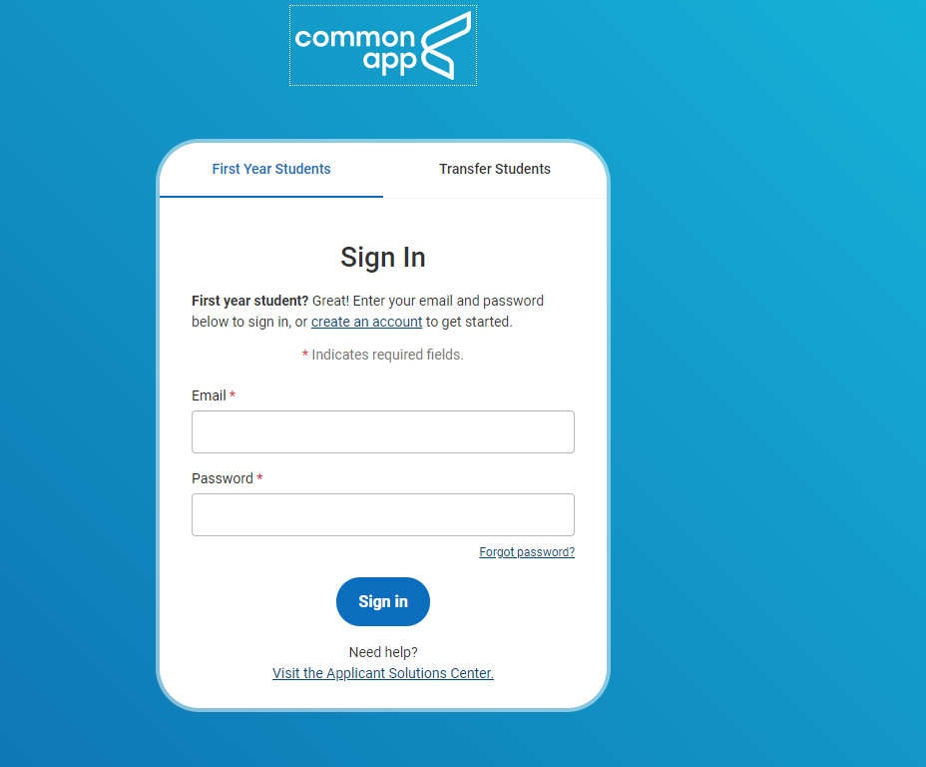
The Common App
A universal application to over 900 colleges

Slide 19
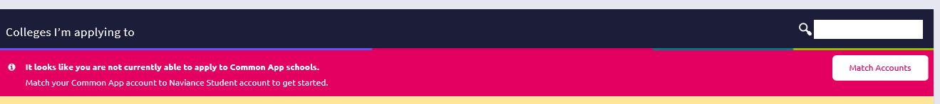
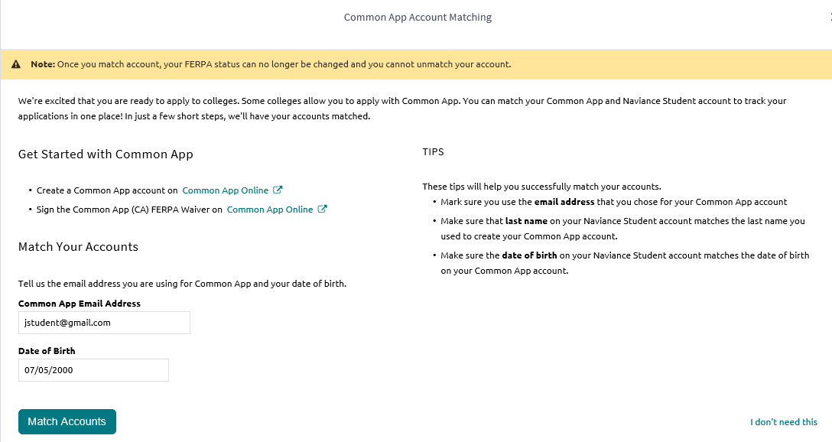
Common App Account Matching

Slide 20

* Matching your Naviance and Common App Accounts
Go To Commonapp.org
Create an account if you don’t have one
Use the same email address as Naviance
Click on the ‘common app’ tab
Click on the ‘education’ tab
Fill out the following information until you get a green checkmark:
  School
    Current school, dates attended; counselor name, phone, and email
  History
    Previous schools, dates attended, past/pending education interruptions, college courses, college assistance programs
  Academic Information
    GPA, class rank, current year courses, honors and awards

Slide 21
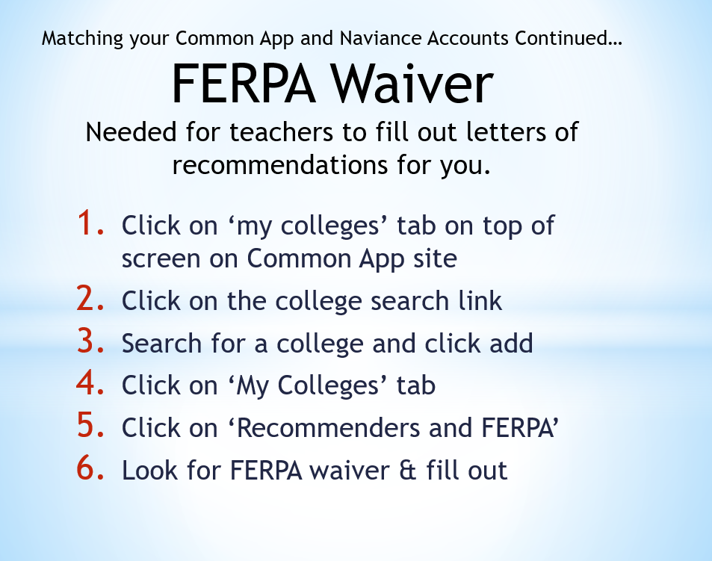

Slide 22
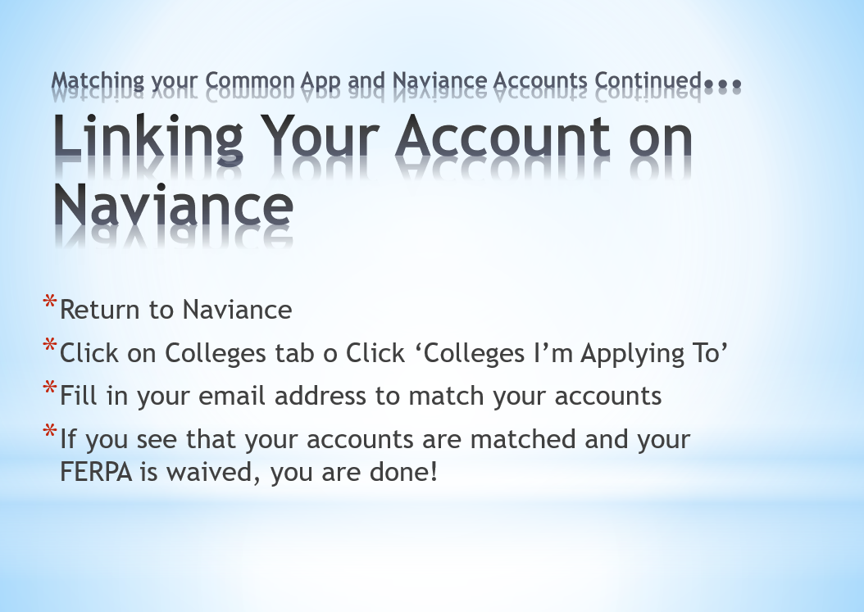

Slide 23
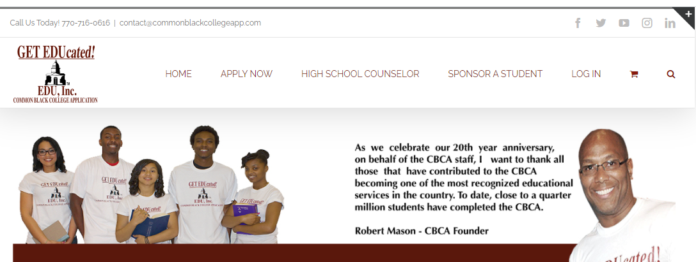
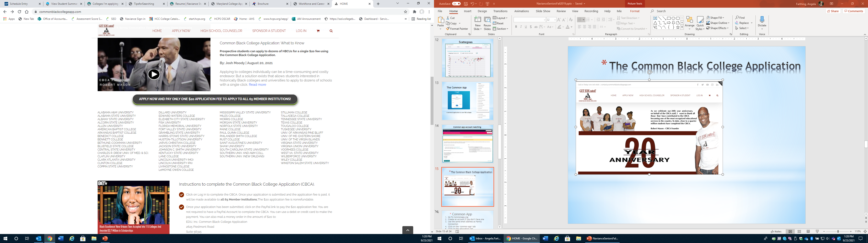
The Common Black College Application www.commonblackcollegeapp.com

Slide 24
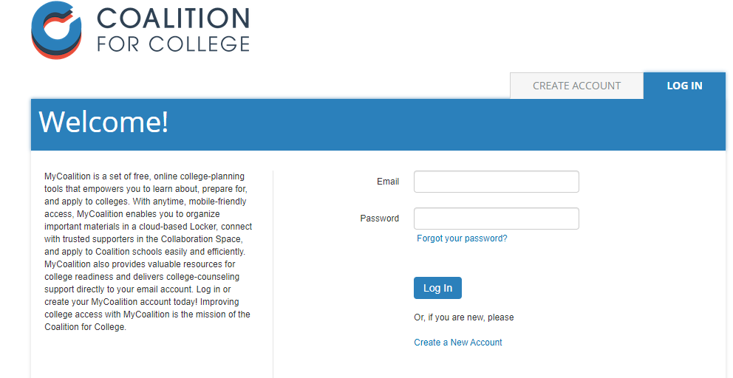
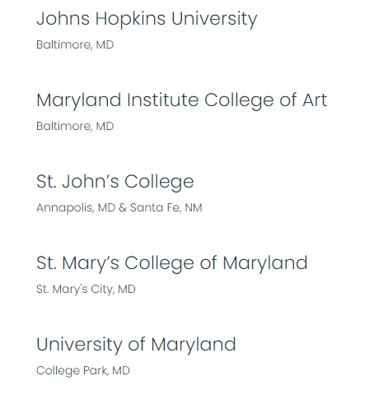
The Coalition App
Students will check a box in the Official Documents portion of their Coalition Application confirming that AHS will send materials via another route or platform
Coalition for College member schools are united in their mission to support lower-income, under-resourced, and/or first-generation students; to provide responsible financial aid; and to bolster students’ success in college—and beyond.

Slide 25
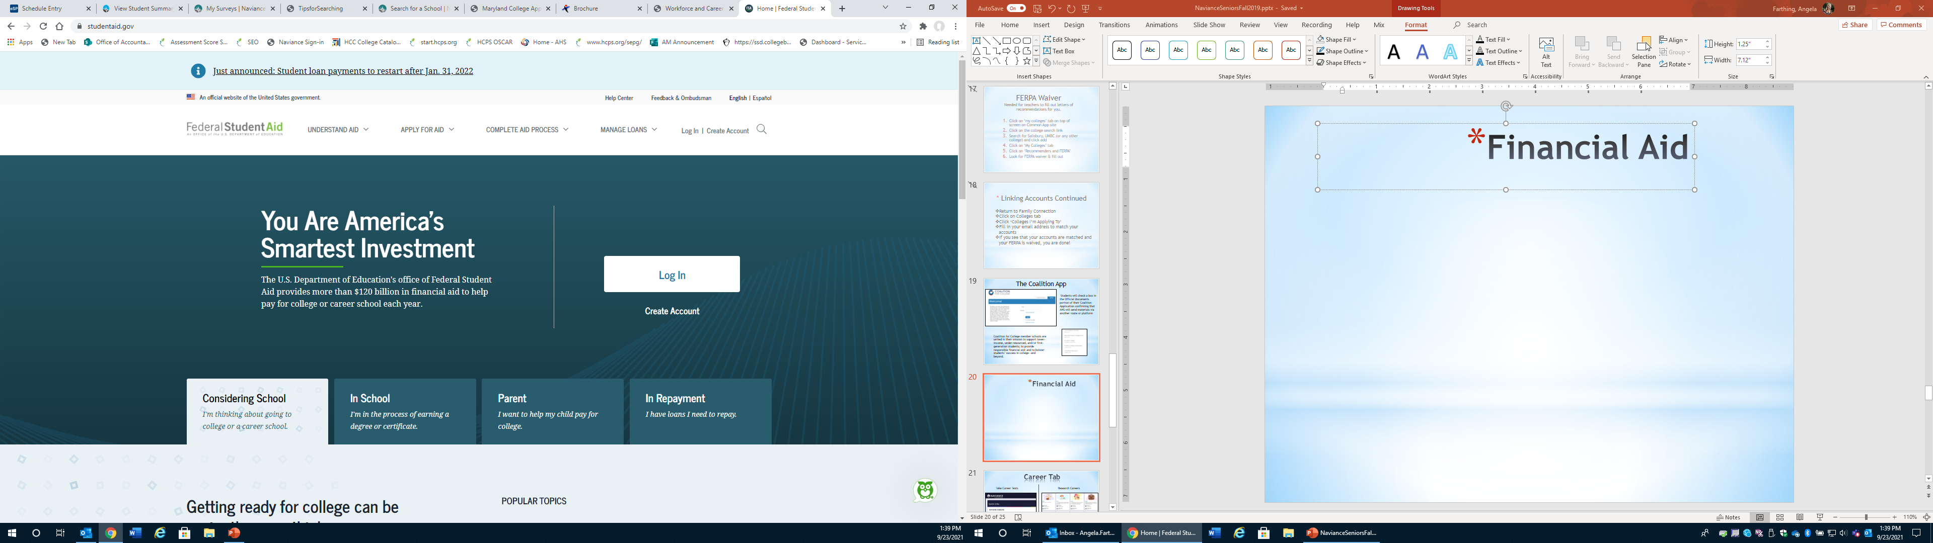

Financial Aid
Free Application Federal Student Aid (FAFSA)
Federal & State Aid
Application opens October 1st
All college bound students should apply
Apply by March 1st
https://studentaid.gov

Slide 26
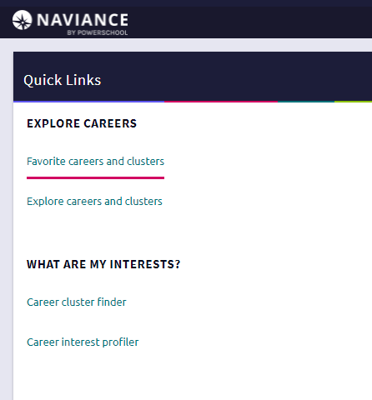
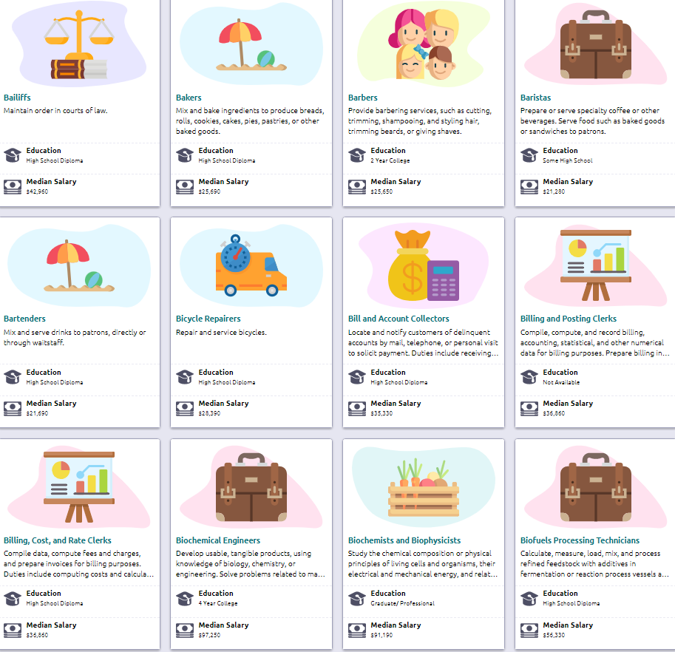
Career Tab
Take Career Tests
Research Careers

Slide 27
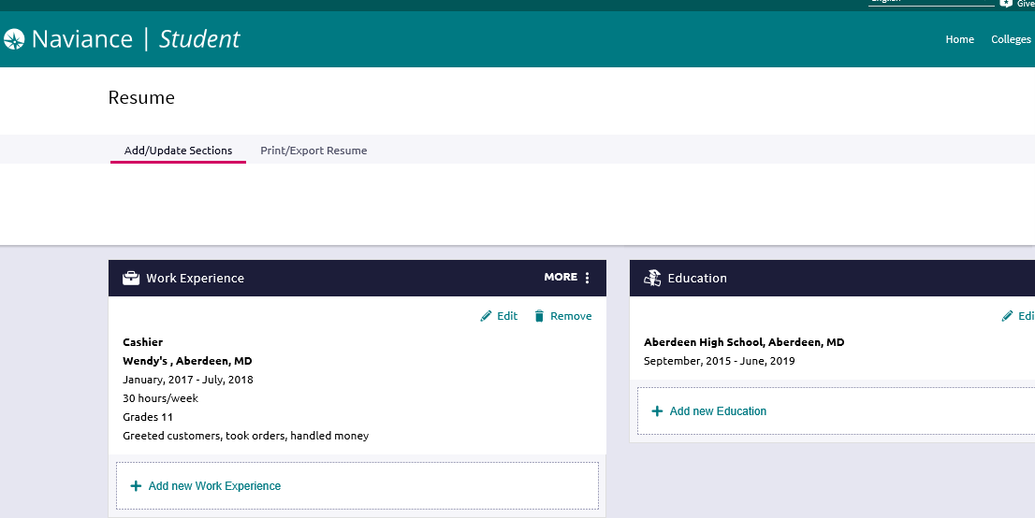

Build Your Resume
About Me Tab
Click Resume

Slide 28
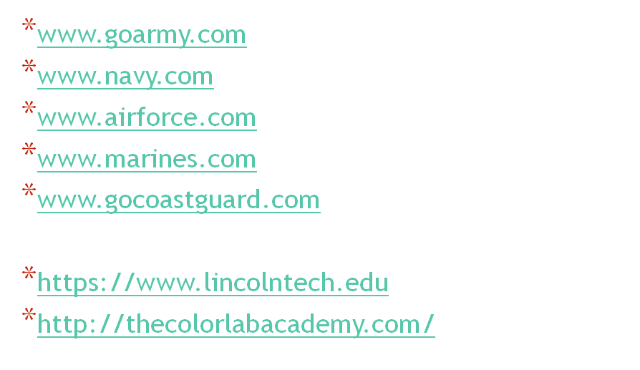
Military or Trade School

Slide 29
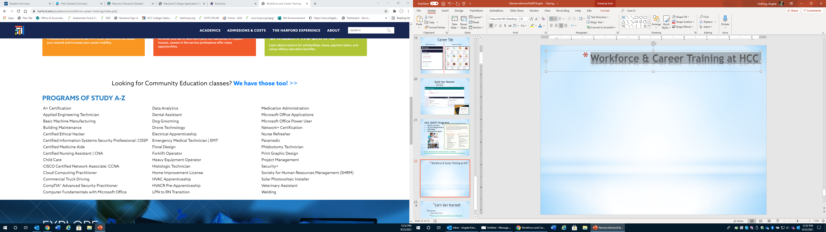
Workforce & Career Training at HCC

Slide 30
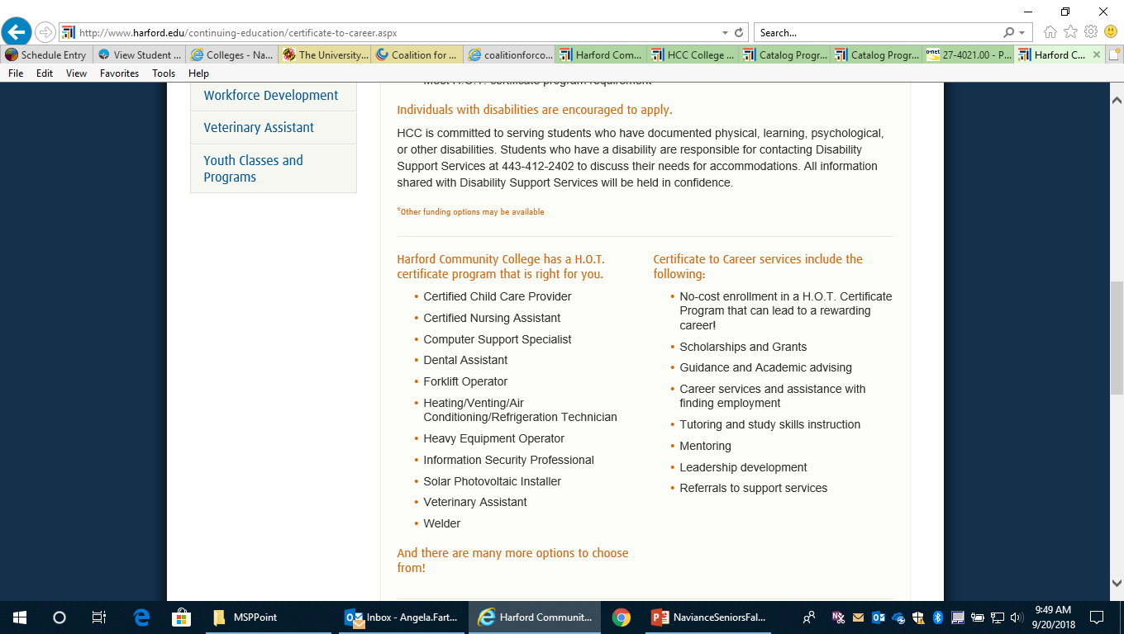
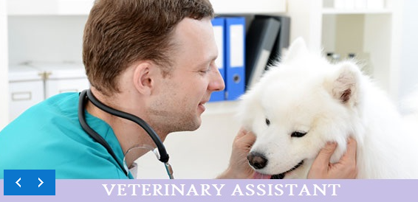

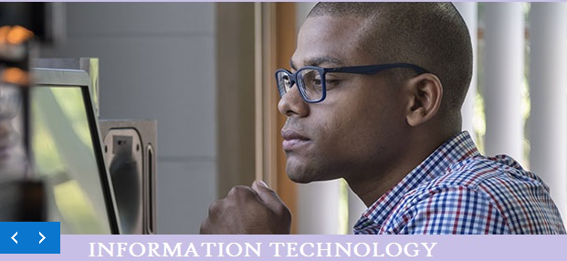
HCC (HOT) Programs High Demand Occupational Training
Shorter Duration
No Core Requirements
Affordable
Educational Support
http://ww2.harford.edu/Catalog/programs_of_study.asp
http://www.harford.edu/continuing-education/certificate-to-career.aspx

